Slide 1
Programming the ATmega328P in C

Slide 2
Why Program the AVR in C?
Compilers produce hex files, which are downloaded into Flash Program ROMs of microcontrollers
The sizes of hex files produced by compilers are of concern to microcontroller programmers, since microcontrollers have limited on-chip Flash Program ROMs
While Assembly-language produces hex files that are much smaller than C, programming in Assembly language is tedious and time-consuming
On the contrary, C programming is less time consuming and much easier although the hex file produced is larger
Some of the reasons for programming the AVR in C are:
  It is easier and less time-consuming to write in C than in Assembly
  C is easier to modify and update
  Code available in function libraries can be used
  C code is portable to other microcontrollers with little or no modification

Slide 3
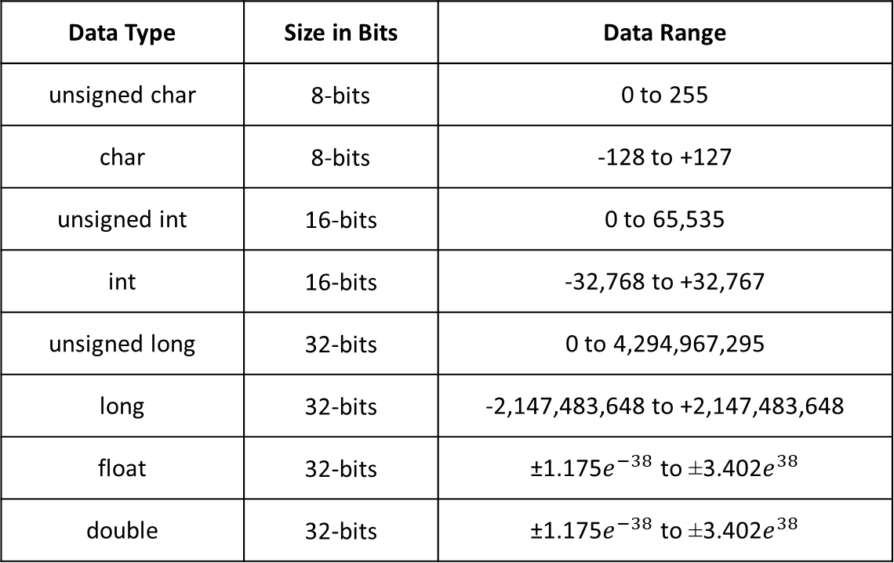
Data Type | Size in Bits | Data Range
unsigned char | 8-bits | 0 to 255
char | 8-bits | -128 to +127
unsigned int | 16-bits | 0 to 65,535
int | 16-bits | -32,768 to +32,767
unsigned long | 32-bits | 0 to 4,294,967,295
long | 32-bits | -2,147,483,648 to +2,147,483,648
float | 32-bits | ±1.175$e^{−38}$ to ±3.402$e^{38}$
double | 32-bits | ±1.175$e^{−38}$ to ±3.402$e^{38}$

Slide 4
unsigned char
It is an 8-bit data-type that takes values in the range 0 to 255 (00 to FFH)
unsigned char takes one byte of RAM
It must be used where there is no need for signed data
unsigned char can be used for ASCII characters
signed char
It is the default char data-type, unless the keyword unsigned is put in front of char
signed char is an 8-bit data-type that uses the MSB to represent the sign (1 representing negative and 0 positive) and 7 bits for the magnitude of the number
signed char takes one byte of RAM
It ranges from -128 to +127
In cases where + and – are needed to represent a given quantity such as temperature, the use of signed char is necessary

Slide 5
unsigned int
unsigned int is a 16-bit data-type that takes values in the range 0 to 65,535 (0000 to $FFFF)
It takes two bytes of RAM and the misuse of int variables will lead to larger hex files, slower program execution and more memory usage
unsigned int must be used for values greater than 255 (not where unsigned char can be used)
signed int
It is the default int data-type
signed int is a 16-bit data-type that uses the MSB for sign and 15 bits for magnitude, and takes values in the range -32,768 to +32,767

Slide 6
I/O Programming in C
All port registers are both byte and bit accessible
To access a port register as a byte, we use PORTx
Example 1
Write a C program to get a byte of data from PORTC. If it is less than 100, send it to PORTB; otherwise, send it to PORTD
Solution (in the next slide)

Slide 7
#include <avr/io.h> //standard AVR header
int main(void)
{
DDRC = 0x00; //PORTC is input
DDRB = 0xFF //PORTB is output
DDRD = 0xFF //PORTD is output
unsigned char temp;
while(1)
{
temp = PINC; //read from PINC
if( temp < 100 )
PORTB = temp;
else
PORTD = temp;
}
return 0;
}

Slide 8
To access a single bit of a given register, use bitwise operators
Bitwise operators include AND(&), OR(|), XOR(^), invert(~), shift right (>>) and shift left (<<)
The following examples use bitwise operators:
  0x35 & 0x0F =0x05 (ANDing)
  0x04 | 0x68 = 0x6C (ORing)
  0x54 ^ 0x78 = 0x2C (XORing)
  ~0x55 = 0xAA (Inverting)
  0x0A >> 1 = 0x05 (shifting right)
  0x0A << 1 = 0x14 (shifting left)
Bitwise ORing, ANDing and XORing can be used to set, clear and toggle bits
  Anything ORed with a 1 results in a 1; anything ORed with a 0 results in no change
  Anything ANDed with a 0 results in 0; anything ANDed with a 1 results in no change
  Anything XORed with a 1 results in the complement; anything XORed with a 0 results in no change

Slide 9
Time Delay
There are three ways to generate a delay in AVR C:
  Using a simple for loop
  Using pre-defined C functions
  Using AVR timers
The frequency of the crystal oscillator is important in determining the time delay
An example program for creating a delay using the for loop is given below:
int main(void)
{
unsigned long i;
for(i = 0; i < 47060; i ++) //assume XTAL = 16
}
Another way to generate a time delay is to use predefined functions _delay_ms() and _delay_us() defined in delay.h in Atmel studio

Slide 10
Write an AVR C program to send 0x55 and 0xAA data alternately to PORTB and PORTC. Write a delay subroutine of 500 ms between alternating the
In Atmel studio, define F_CPU before using delay.h
An example program using _delay_ms() is given below:
#define F_CPU 16000000 //XTAL = 16 MHz
#include <util/delay.h> //delay loop function
#include <avr/io.h> //standard AVR header
int main(void)
{
DDRB = 0xFF; //PORTB is output (all ports or pins in the “B” I/O port act as outputs.) (DDRB = 0b11111111)
while(1) //toggling all inputs of PORTB
{
PORTB = 0xAA;
_delay_ms(500); //wait 0.5 sec
PORTB = 0x55;
_delay_ms(500); //wait 0.5 sec
}
return 0;
}

Slide 11
Program Repeating Indefinitely versus Program Stopping
For a program to repeat indefinitely, for example in monitoring, use:
int main(void)
{
while(1)
{
X //statements
}
return 0;
}
For a program to stop at some point until the microcontroller is reset, use:
int main(void)
{
X //statements
while(1);
return 0;
}

Slide 12
Masking
Masking is a process of hiding information that is not required
We mask through bit-wise ANDing with a masking byte (with 0’s on bits to hide and 1’s on bits needed)
For example, we have eight switches connected to PORTD (one Switch to each pin), and we want to read only PD3 and PD4.
In this example, we only need information of PD3 and PD4 and, so, we mask with 1’s those pins and others with 0’s.
Therefore, the masking byte is 00011000 and the instruction is: (PIND & 0x18)
We apply masking in reading desired input pins, for example reading data supplied to input pins or reading switches (to check their statuses - if closed or open)
Swapping Nibbles
This is done through masking followed by shifting 4 times to the right for lower nibble and to the left for upper nibble of a port

Slide 13
Examples
Example 1: Configure Port B as 8 channels of input with the internal pull-up resistors on.
DDRB = 0x00; // set PortB as input with internal pull-ups on
PORTB = 0xFF;
Example 2: Configure Port B as 8 channels of input with the internal pull-up resistors off.
DDRB = 0x00; // set PortB as input with internal pull-ups off
PORTB = 0x00;
Example 3: Configure Port B as 8 channels of output.
DDRB = 0xFF; // set PortB for output
PORTB = 0x00;
Example 4: Configure the upper 4 bits of Port B for input with pull-up resistors and the lower 4 bits for output.
DDRB = 0x0F; // set PortB for both input and output
PORTB = 0xF0; // upper 4 => input, lower 4 => output
Example 5: Configure the even bits to be input and the odd bits to be output.
DDRB = 0xAA; // set PortB for both input and output
PORTB = 0x55; // pull-ups are on.
Notes:
Input is Zero; Output is 1
https://web.ics.purdue.edu/~jricha14/Port_Stuff/PortB_general.htm

